Slide 1

ME 224 Course Project
Gravity Escapement
05/06/2024
Ayush Gupta
220103026
by
Ayush Singh
220103027
Department of Mechanical Engineering
Indian Institute of Technology Guwahati

Slide 2
Motivation and Application
Motivation -
To explore the historical roots of precision timekeeping and understand the ingenuity of early clock designs.
To challenge our engineering skills through the precise fabrication and assembly of a delicate working mechanism.
To appreciate the simple elegance of the gravity escapement and its timeless, rhythmic operation.
Application -
Tower Clocks – Most common application. Since gravity escapements are less affected by driving force, they offer great accuracy in clocks exposed to external conditions.
Horology Studies - They provide students with a tangible understanding of early clock design and the fundamental principles of timekeeping.

Slide 3
Kinematic Analysis
For the pendulum, time period for oscillation(t) = 2*pi*root(I/mgd)
where, I = moment of inertia about axis of rotation
m = mass
d= distance of center of mass from hinge point
If in t time, escapement wheel rotates 1 teeth then,
Rotation speed of the escapement wheel = (60/(n*t)) rpm
Where n = number of teeths on the escapement wheel
So, rotation speed of the escapement wheel = (60/(n*2*pi*root(I/mgd))) rpm

Slide 4
Kinematic Synthesis
If we need to make a seconds hand using the escapement wheel, we need
n = 60 and rpm=1
Means t = 1sec
So, 2*pi*root(I/mgd) = 1
I/mgd = 1/(4*pi^2)

Slide 5

Computer Aided Design

Slide 6
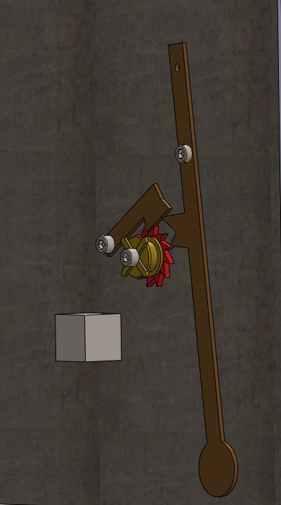
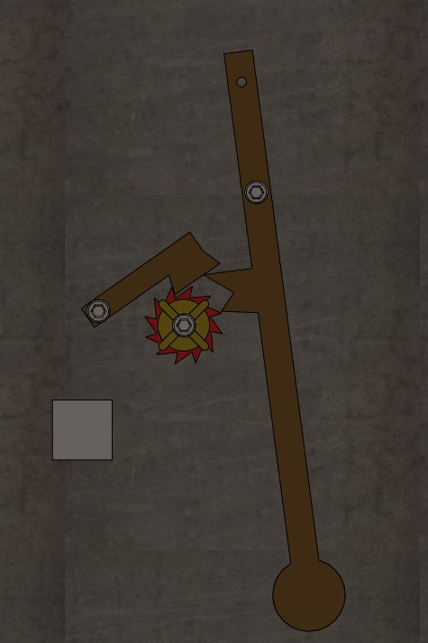

Slide 7
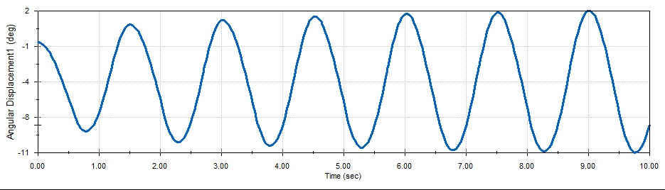
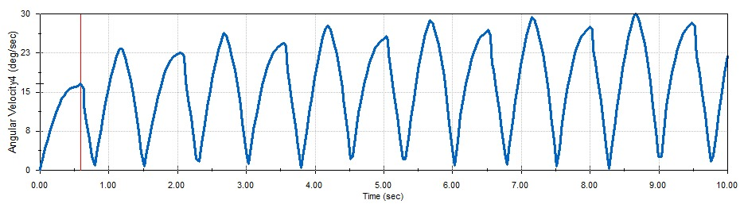
Motion Analysis / Study
Pendulum -

Slide 8
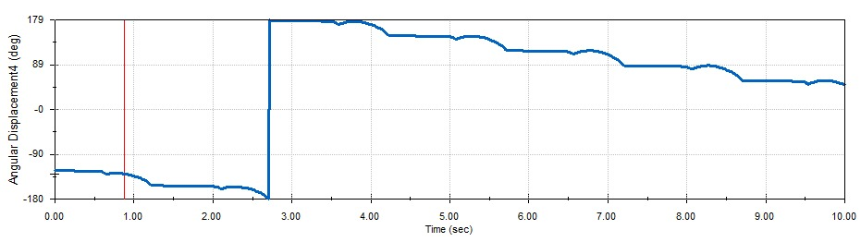
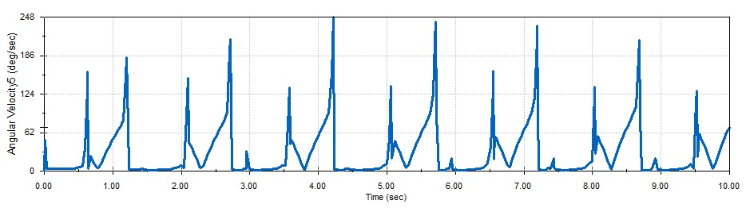
Gear -

Slide 9
Fabrication Details (Optional)
Breakdown of the fabrication details for a gravity escapement
Escape Wheel : Precision machining (lathe, milling machine) to create angled teeth. Hardening may be necessary for wear resistance.
Pallets : careful polishing of contact surfaces to minimize friction. Angled surfaces must match the escape wheel design.
Pendulum : Low thermal expansion material like Invar for temperature stability. Mechanism to finely adjust the pendulum's effective length for accurate timekeeping.
Frame and Support : Machining or woodworking, focusing on precision alignment of bearings for low friction.

Slide 10
Conclusions
Significance - Building the gravity escapement provided a unique understanding of the challenges and ingenuity of early clockmakers. It demonstrates the fundamental principles that paved the way for more complex and accurate timekeeping.
Learning - This project highlighted the importance of precision fabrication and alignment for the efficient and accurate function of the escapement. It illustrated the delicate balance between potential energy, controlled release, and the regulation of an oscillator.
Challenges - Through testing, we observed the gravity escapement's sensitivity to disturbances [or changes in weight]. This points to potential refinements in the design or the need for careful environmental control for reliable timekeeping.

